Slide 1
TECHNICAL AIRCRAFT RECOVERY &
TECHNICAL CRASH CREW

Slide 2
AUSTRIAN AIRCRAFT
EUROFIGHTER TYPHOON (EFT)
PILATUS PC7 TRAINER
DIAMOND DA40NG
LOCKHEED C130 HERCULES
PILATUS PC6 PORTER
SIKORSKY S70 BLACK HAWK
AGUSTA-BELL AB212
BELL O-58 KIOWA
SUD AVIATION 316 ALOUETTE III

Slide 3
EFT

Slide 4
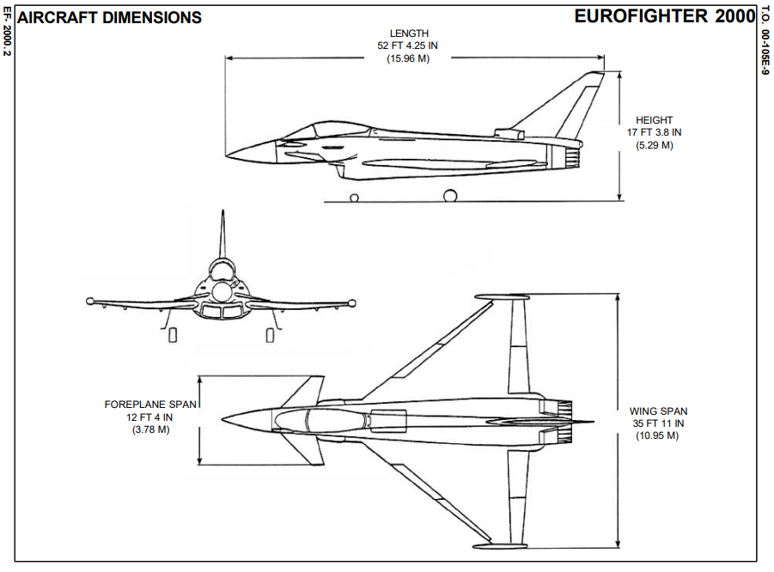

Slide 5
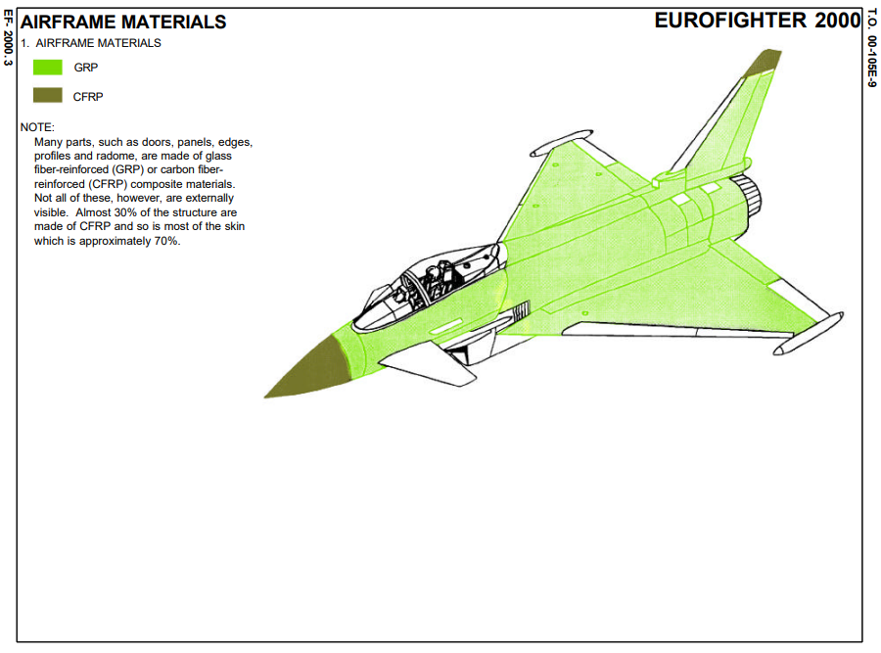

Slide 6
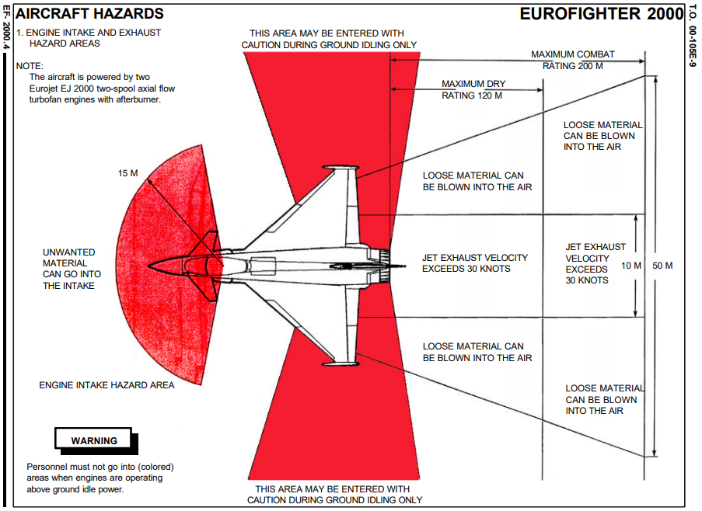

Slide 7
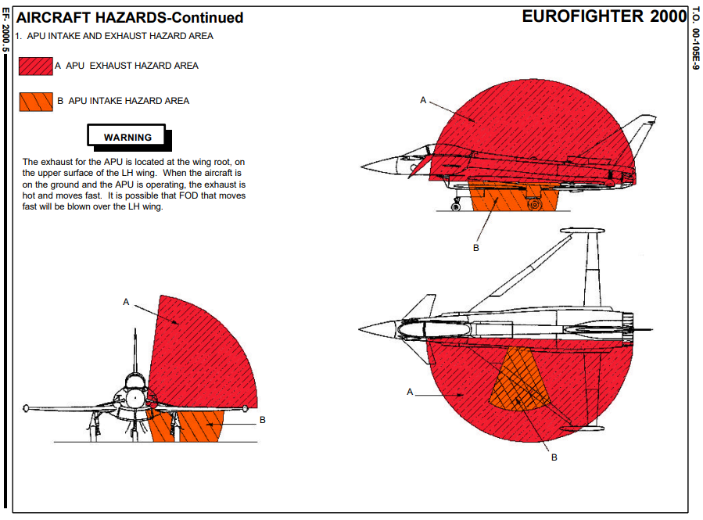

Slide 8
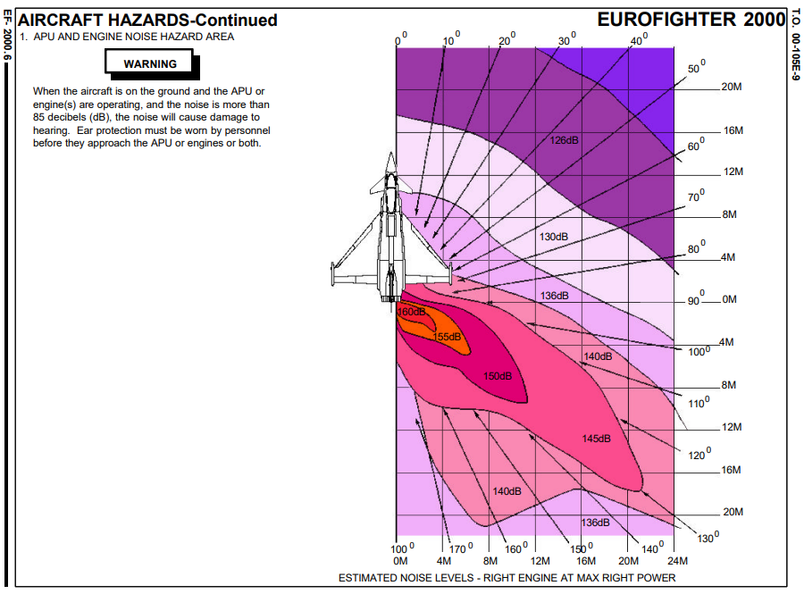

Slide 9
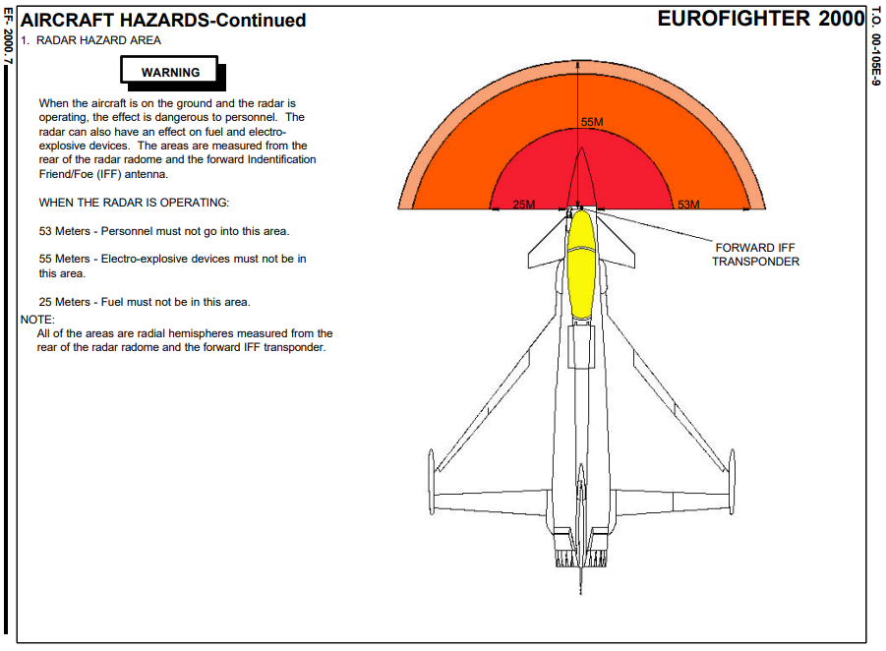

Slide 10
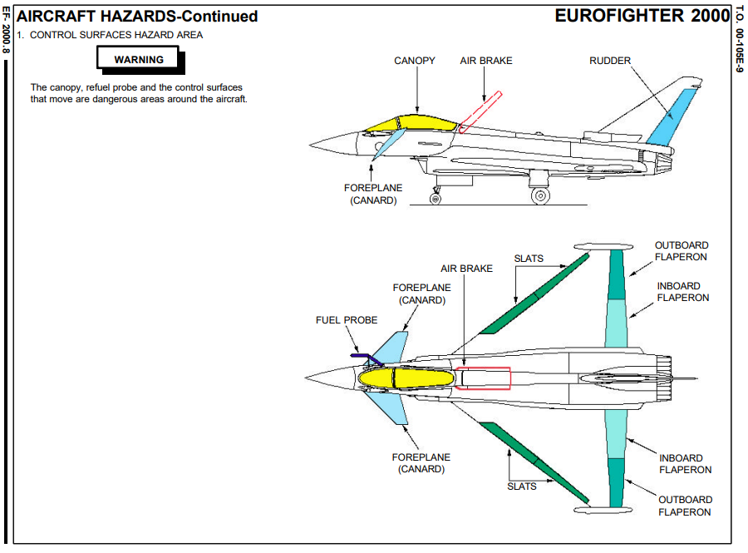

Slide 11
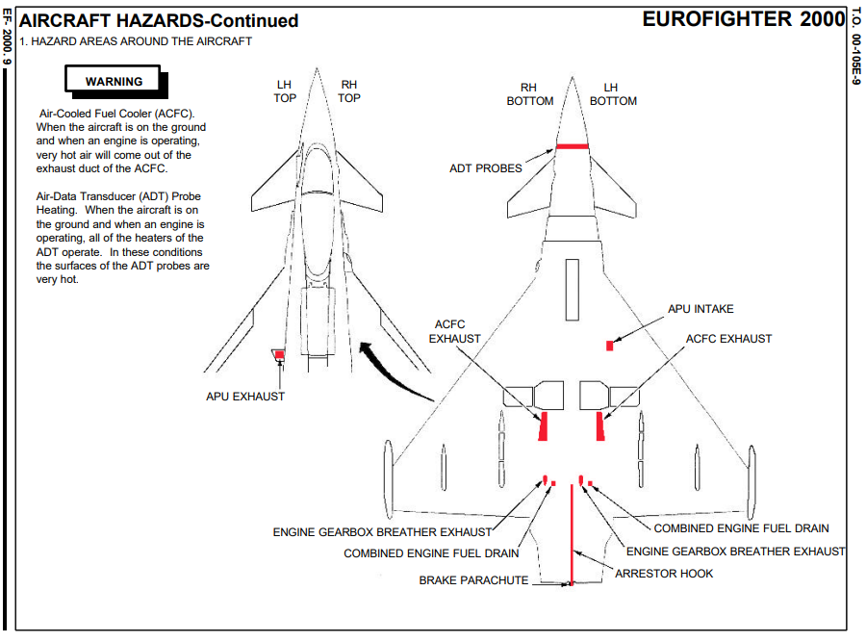

Slide 12
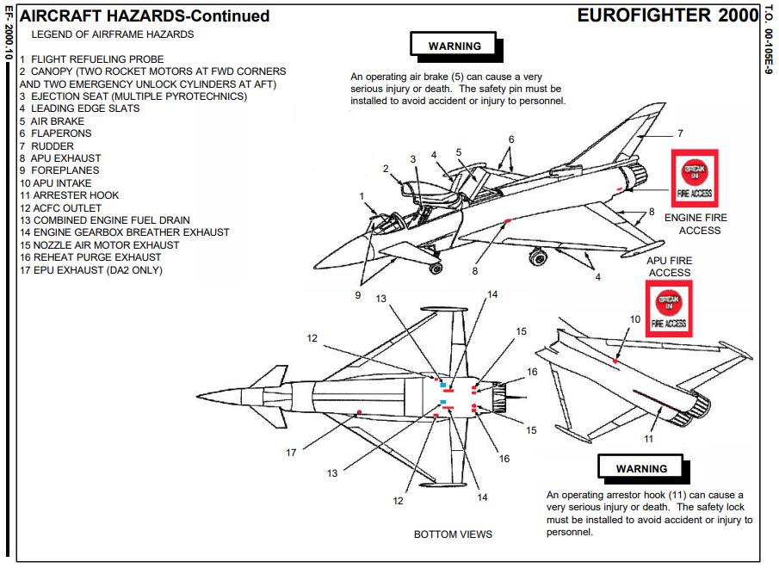

Slide 13
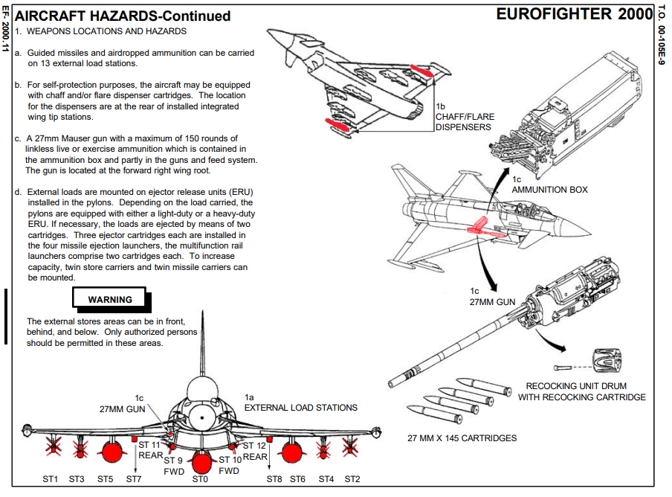

Slide 14
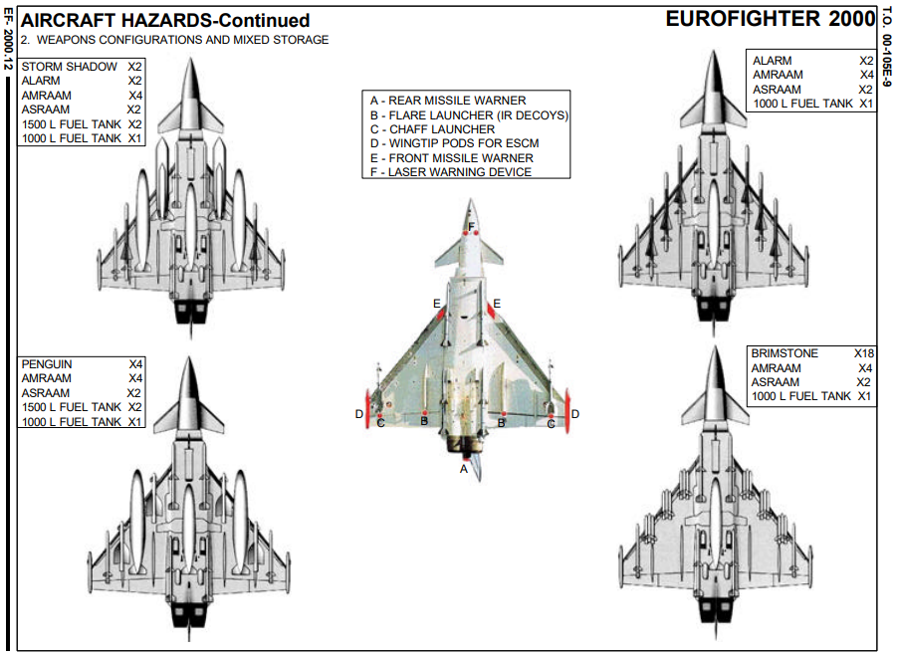

Slide 15
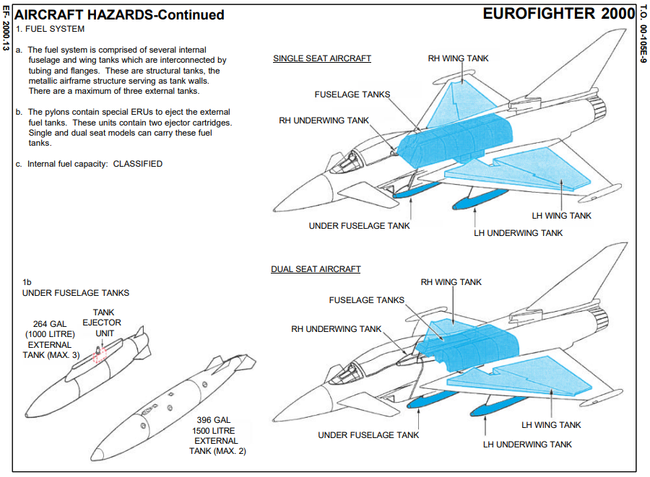

Slide 16
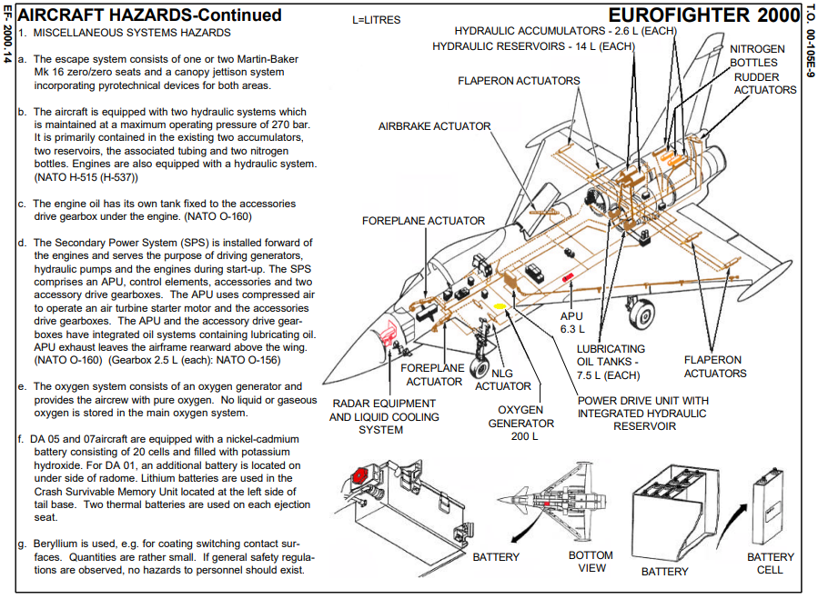

Slide 17
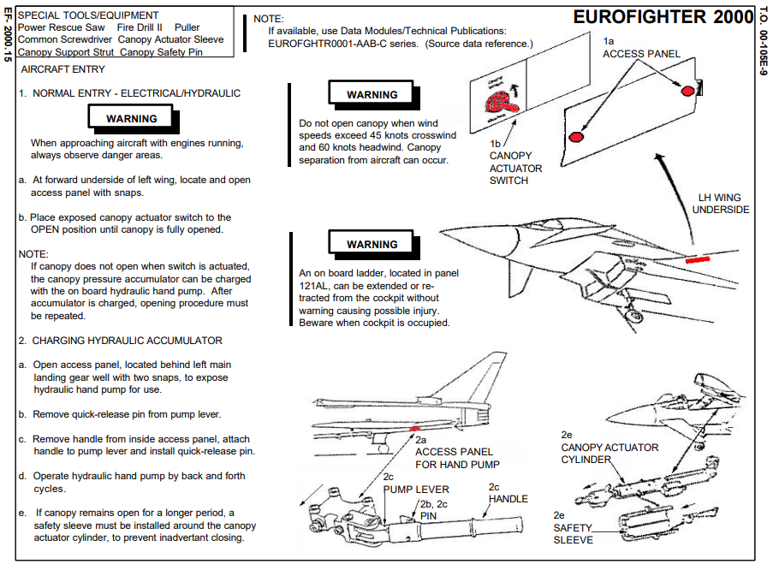

Slide 18
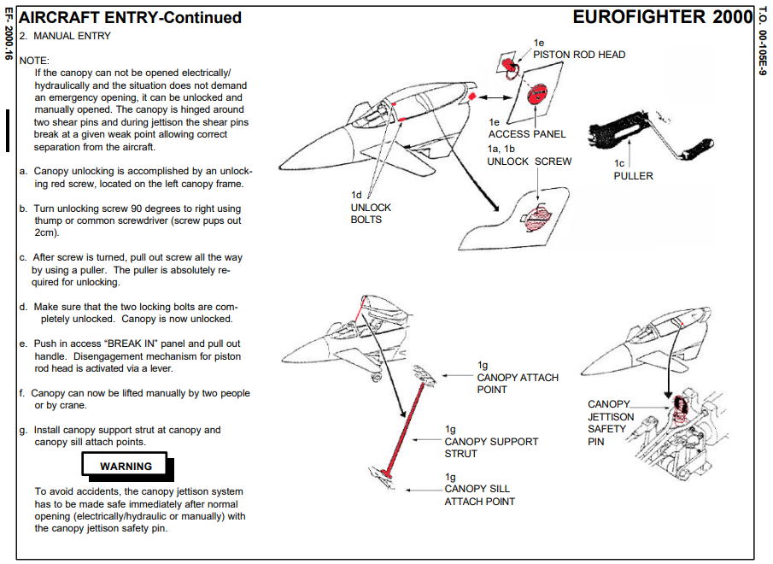

Slide 19
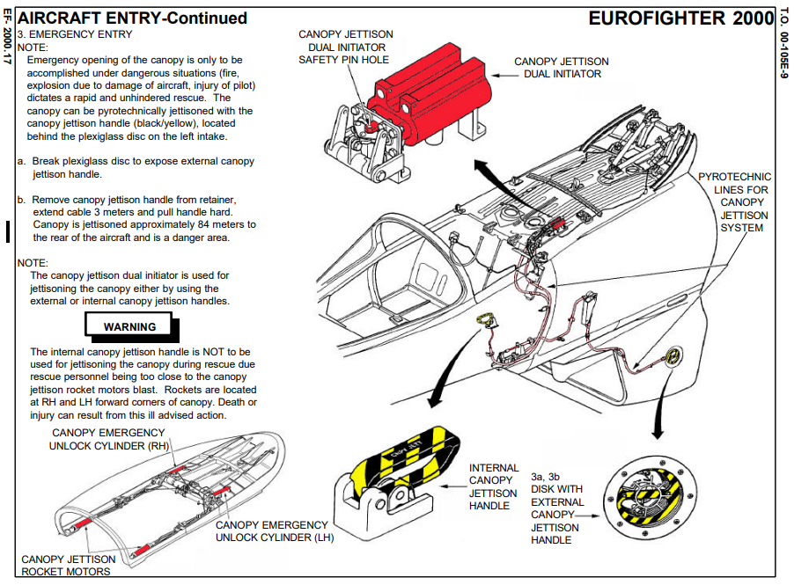

Slide 20
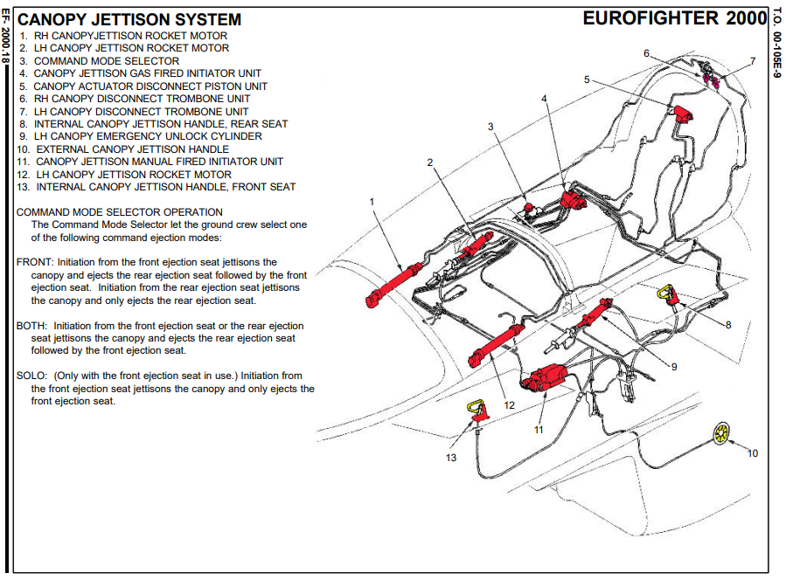

Slide 21
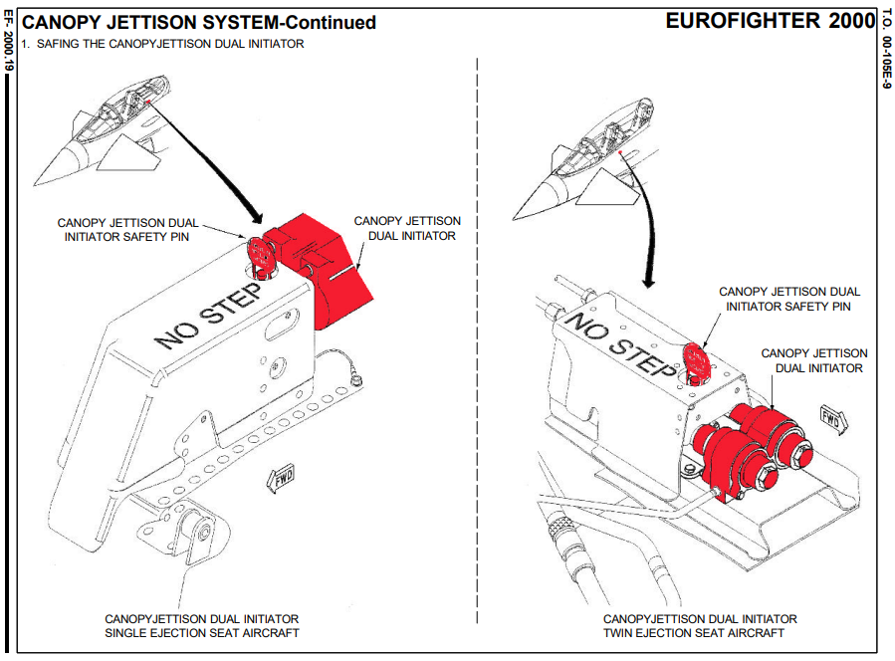

Slide 22
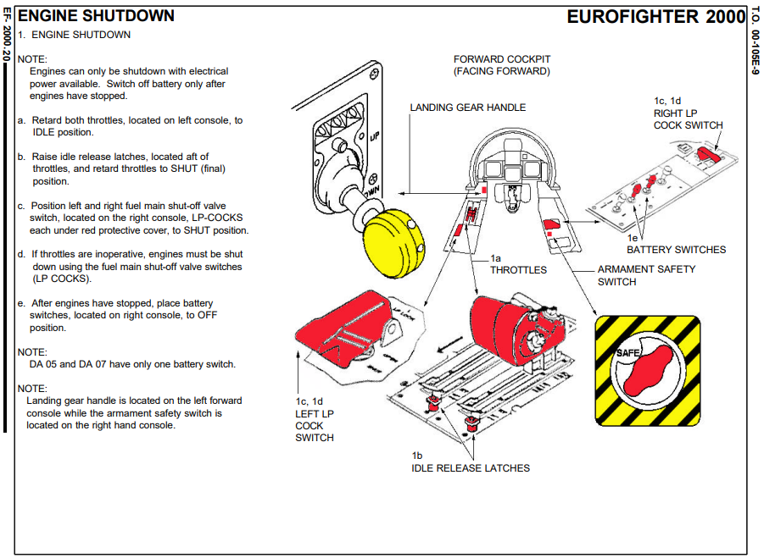

Slide 23
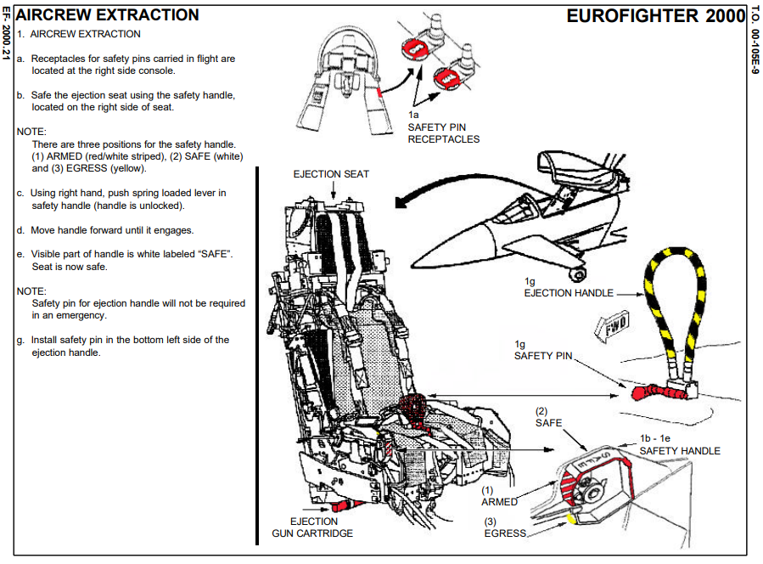

Slide 24
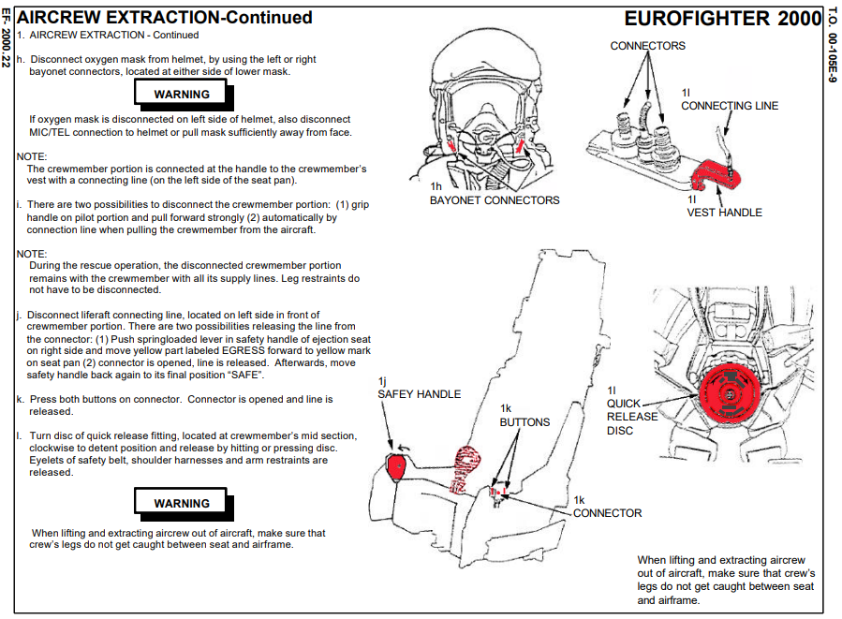

Slide 25
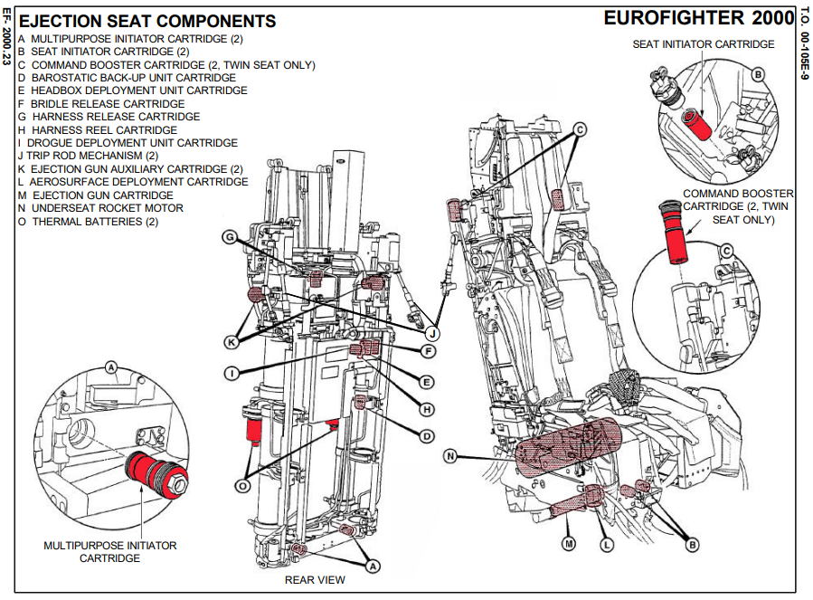

Slide 26
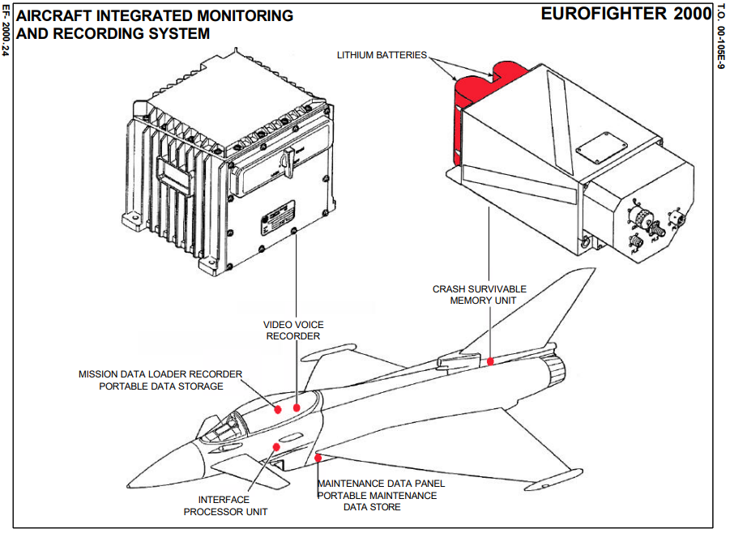

Slide 27
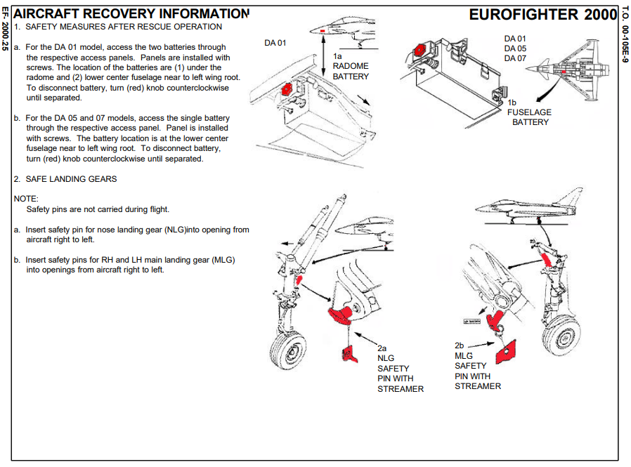

Slide 28
C-130

Slide 29
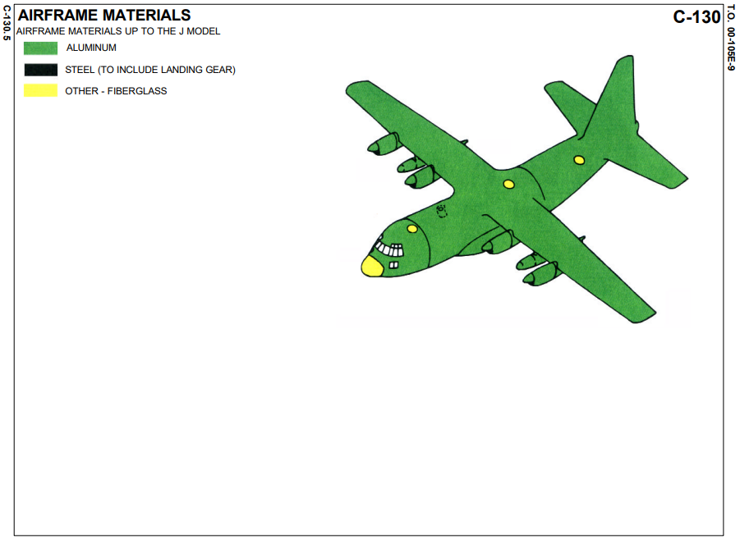
C130

Slide 30
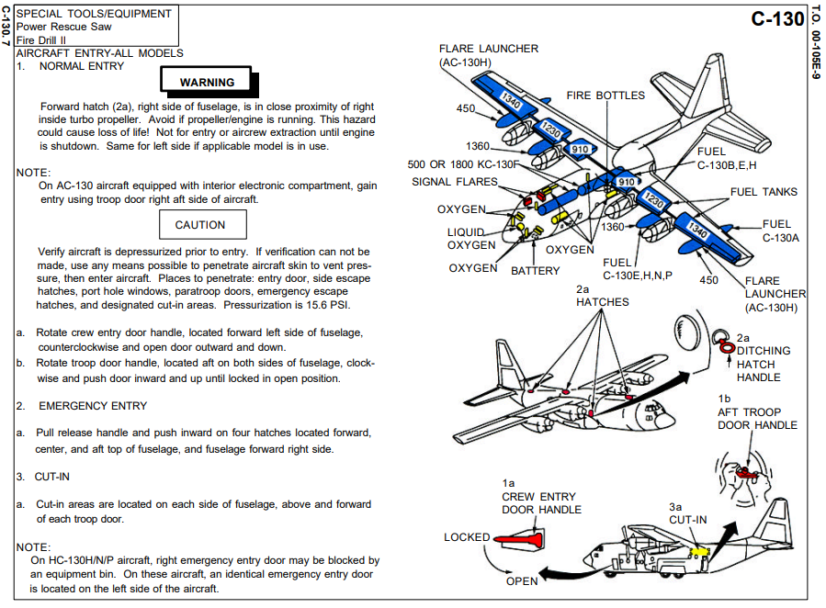

Slide 31
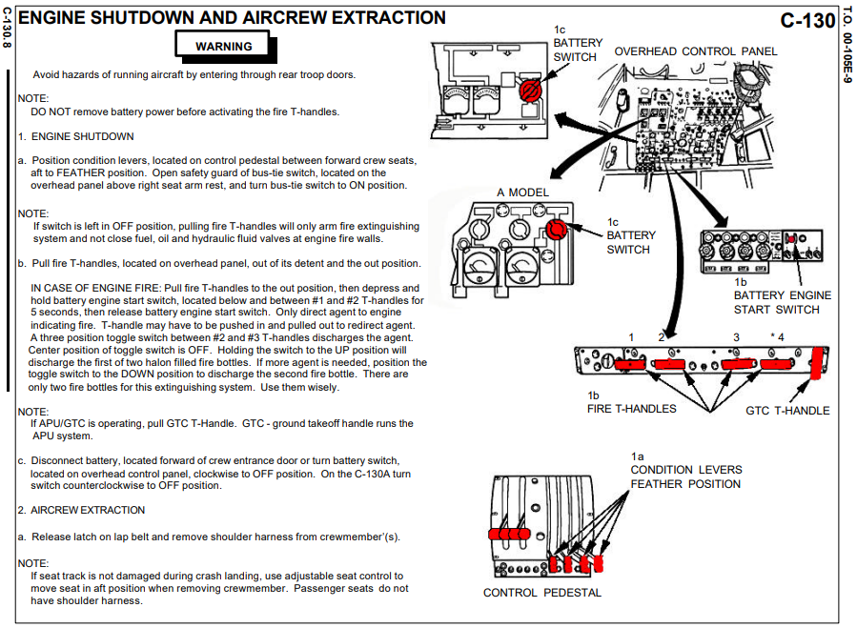

Slide 32
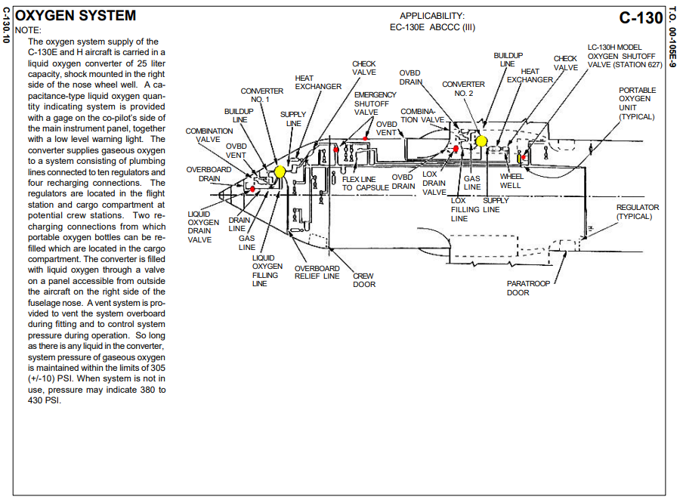

Slide 33
PC-6 PORTER

Slide 34
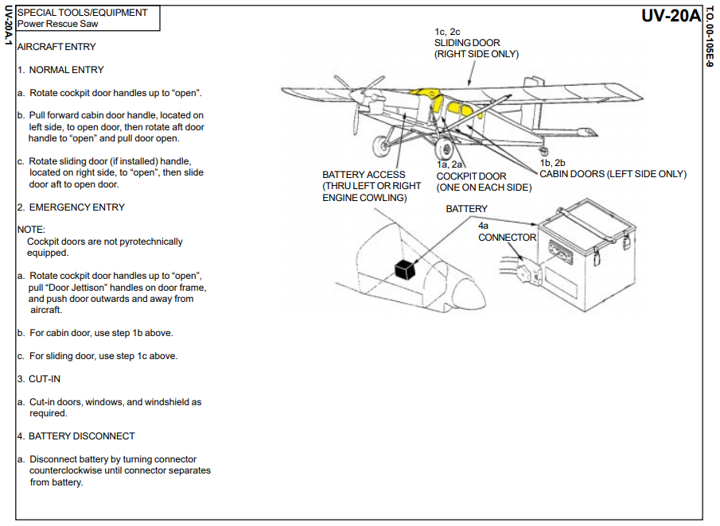

Slide 35
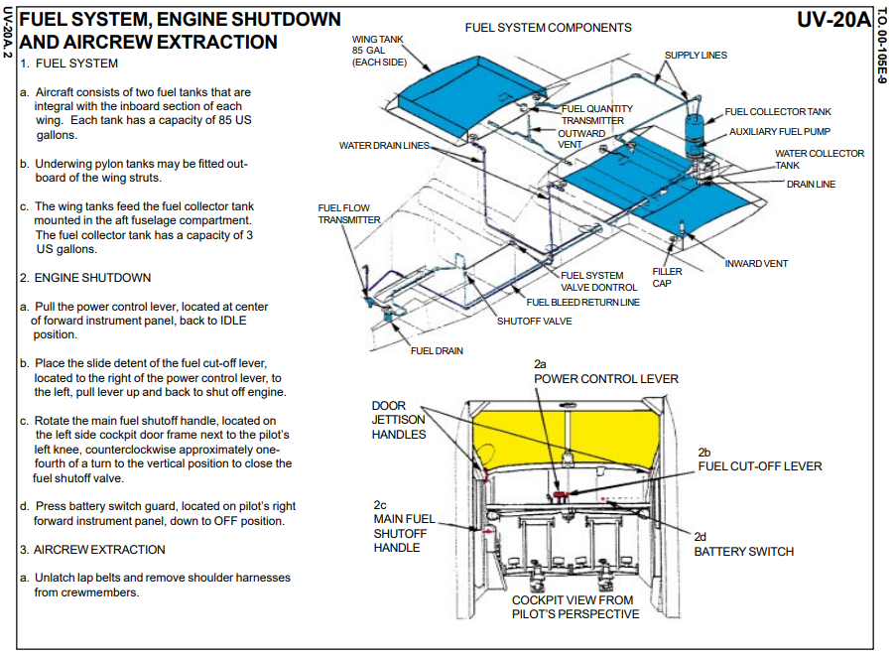

Slide 36
AB212 (UH-1N)

Slide 37
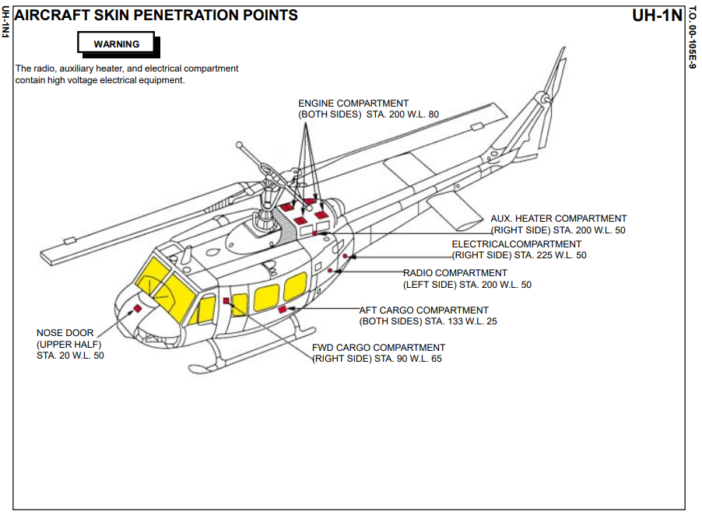

Slide 38
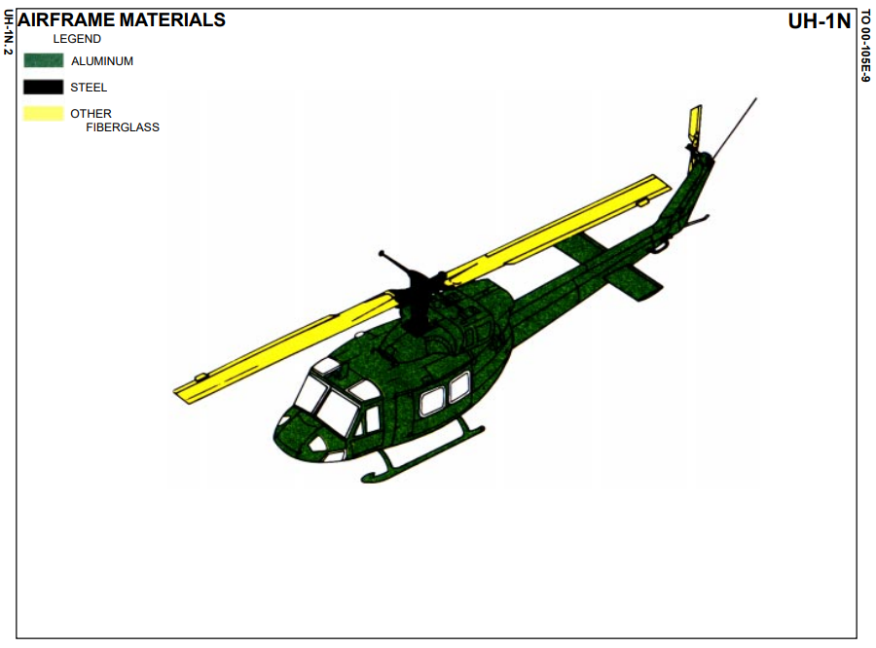

Slide 39
S70 BLACK HAWK

Slide 40
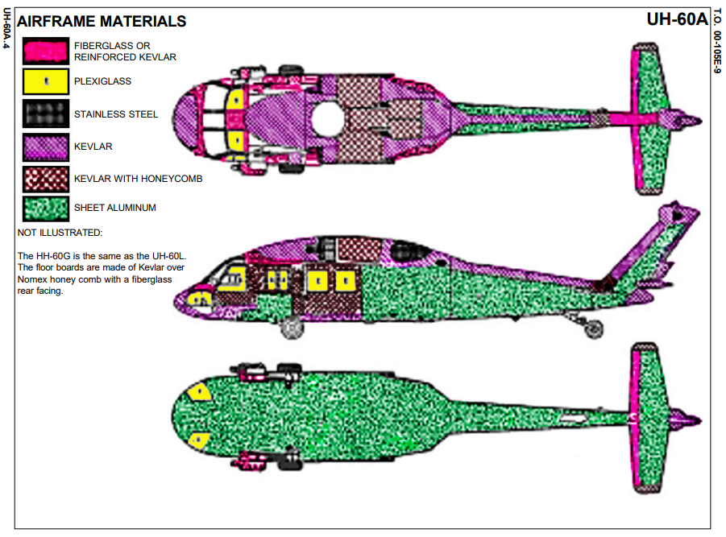

Slide 41
OH-58 KIOWA

Slide 42
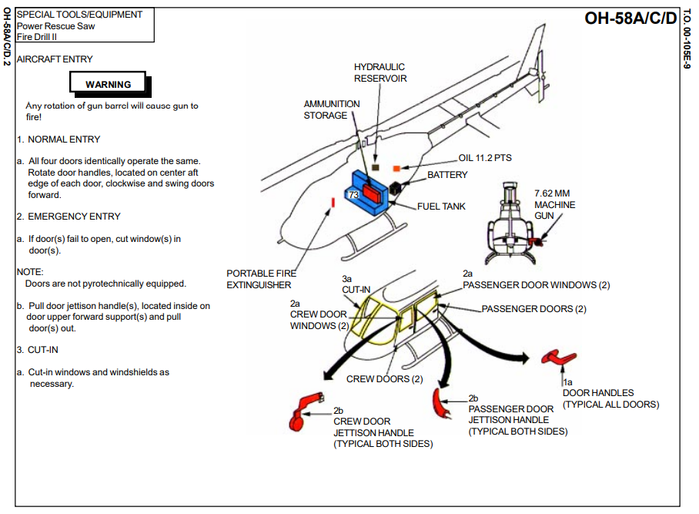

Slide 44
RED BULL AIRCRAFT
ALPHA JET
AH-1 COBRA

Slide 45
ALPHA JET

Slide 46
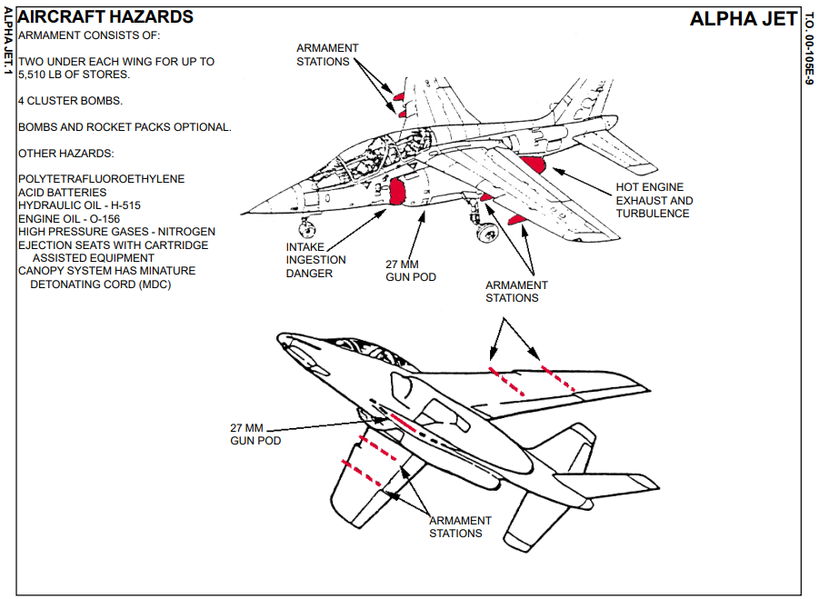

Slide 47
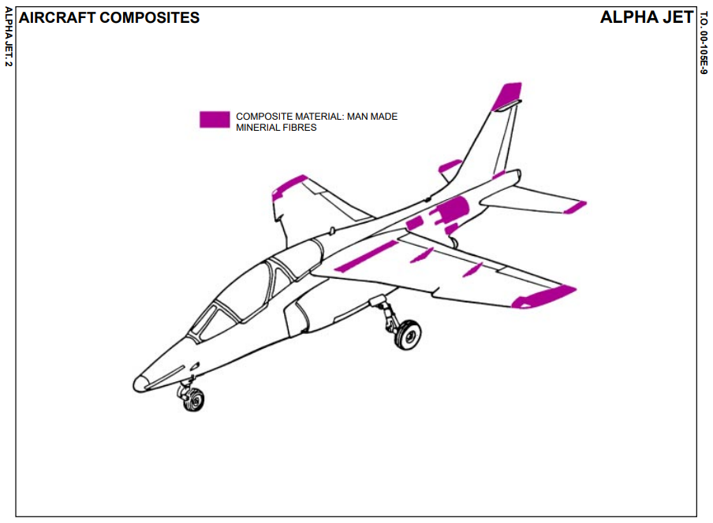

Slide 48
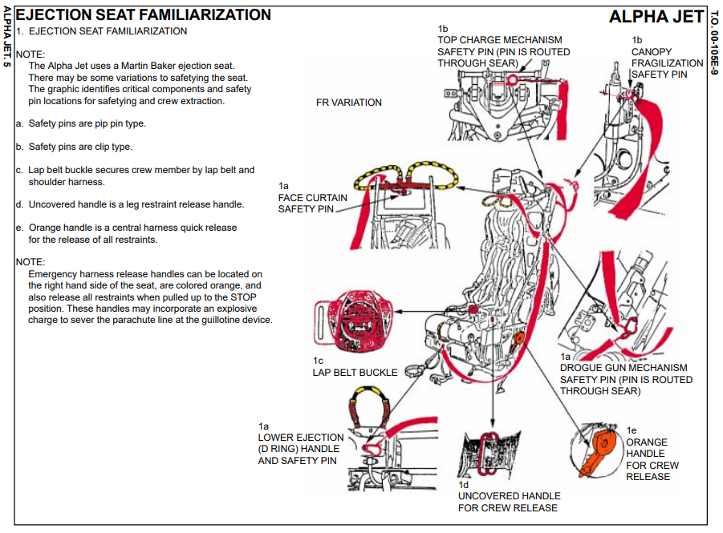

Slide 49
AH-1 COBRA

Slide 50
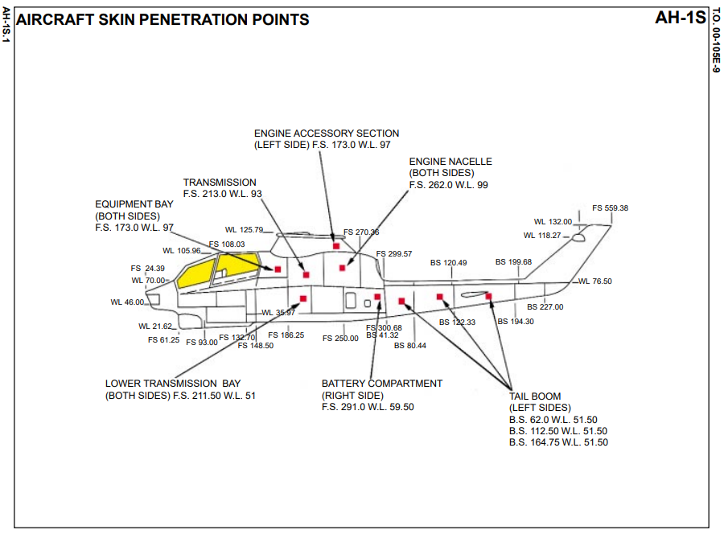

Slide 51
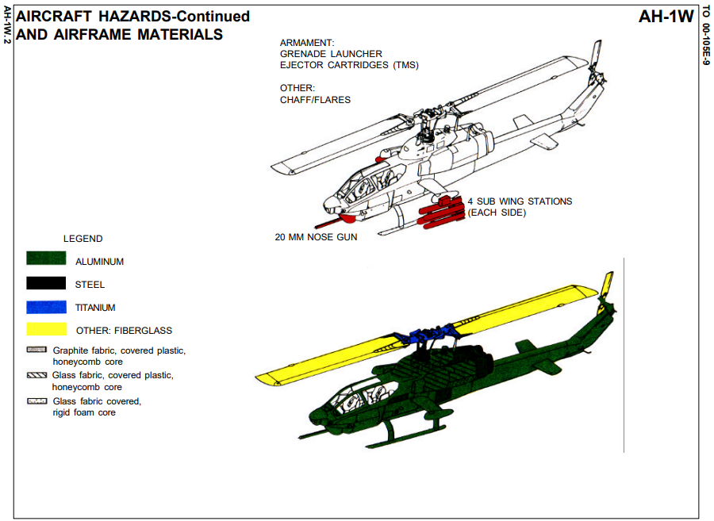

Slide 52
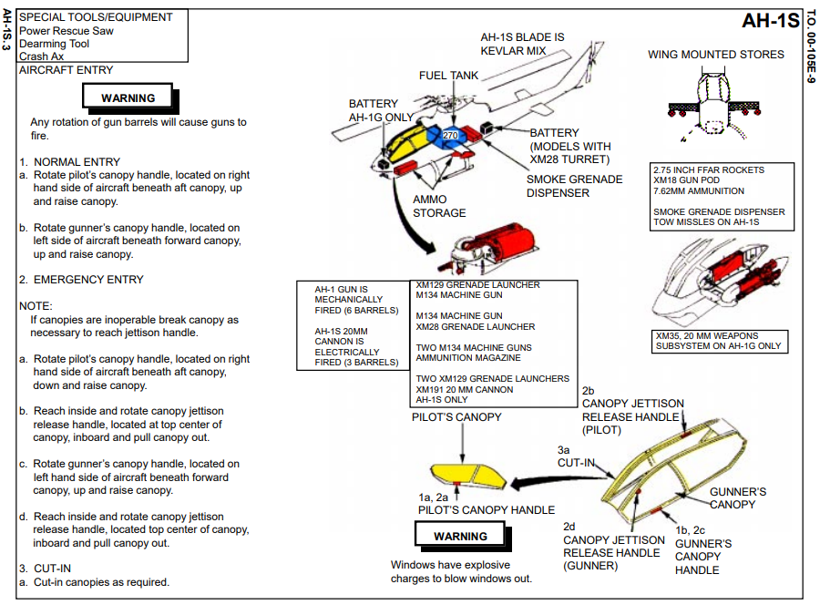

Slide 53
FOREIGN AIRCRAFT
F5 TIGER

Slide 54
F-5 TIGER
SWITZERLAND

Slide 55
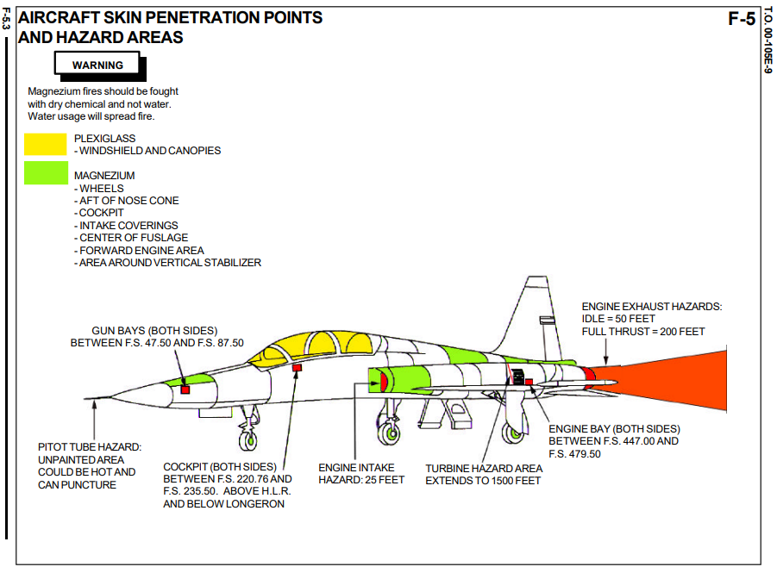

Slide 56
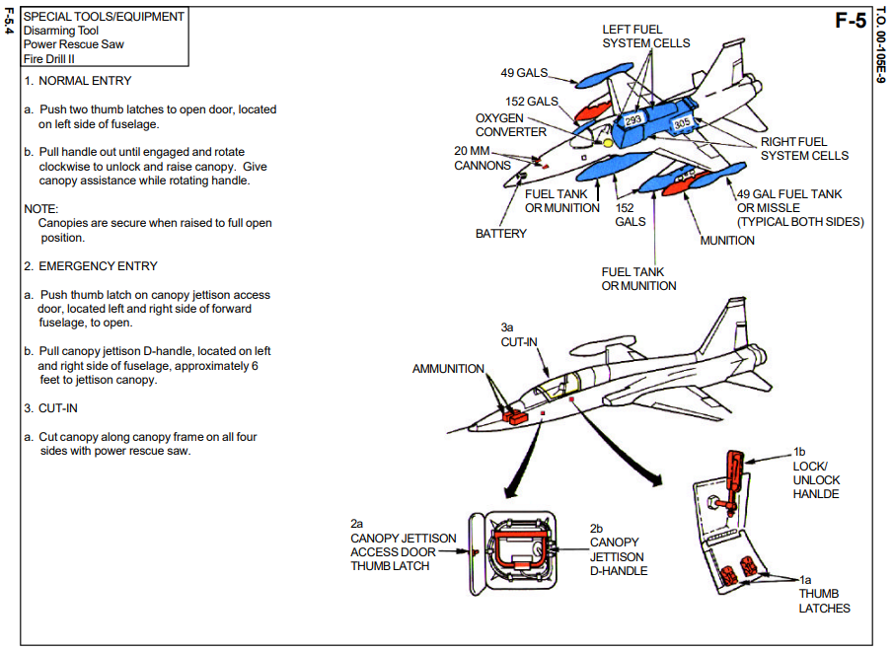

Slide 57
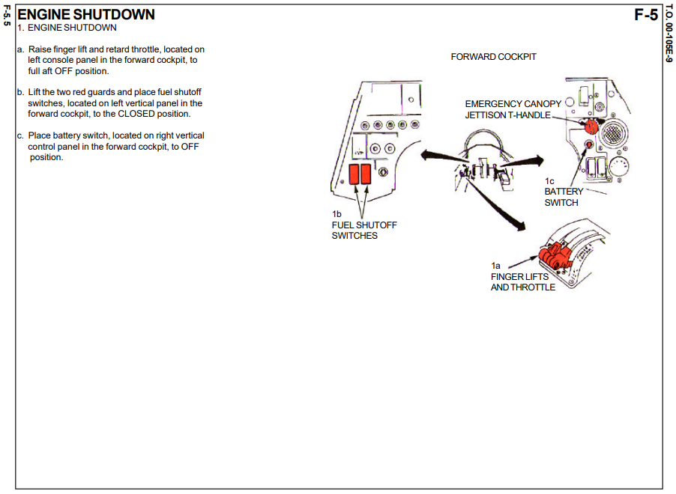

Slide 58
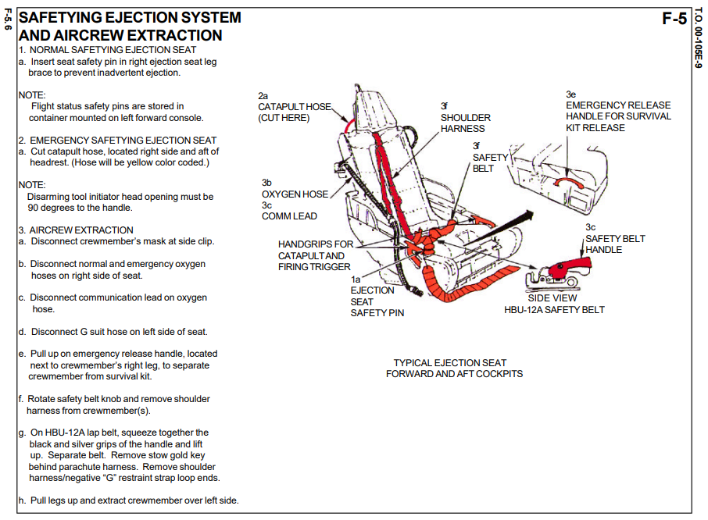

Slide 59
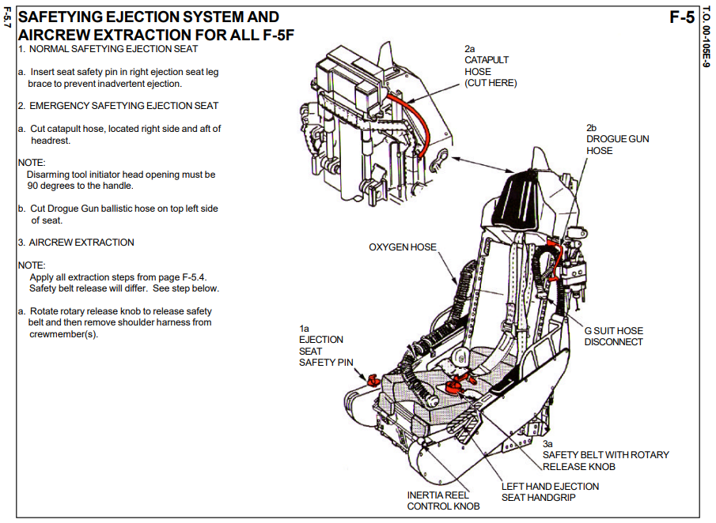

Slide 60
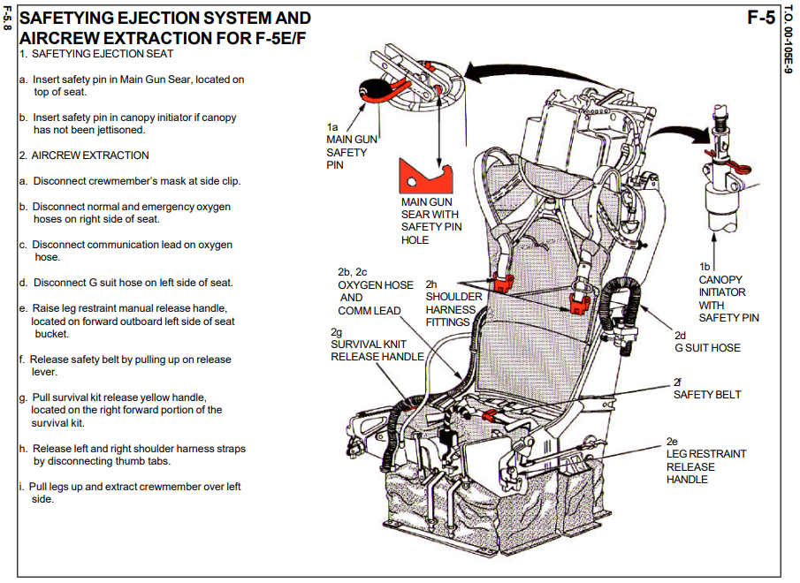

Slide 61
F-16 FALCON

Slide 62
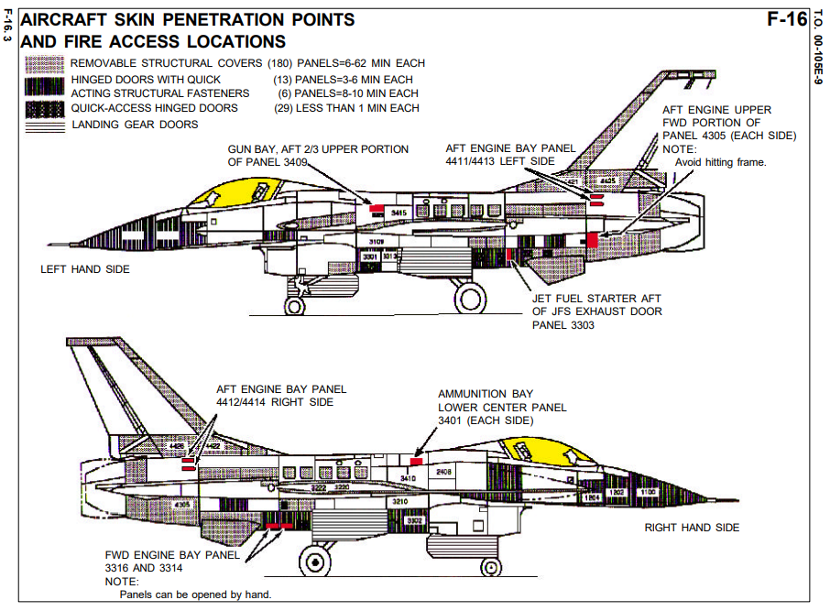

Slide 63
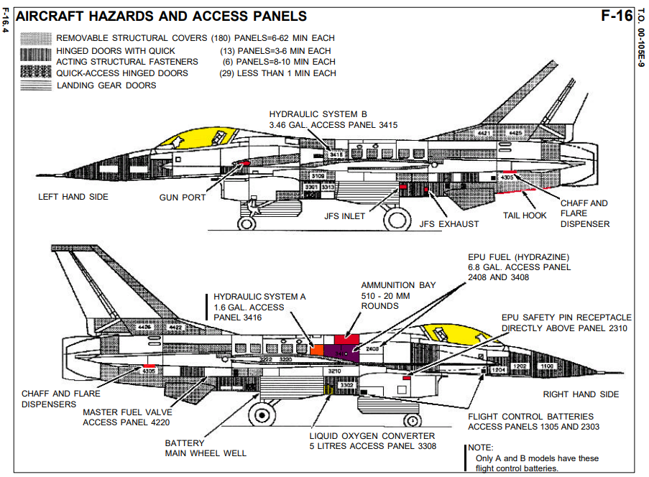

Slide 64
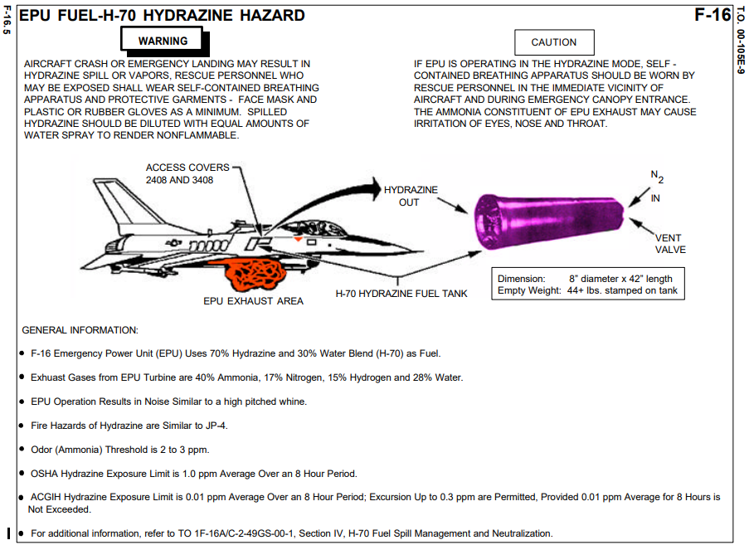

Slide 65
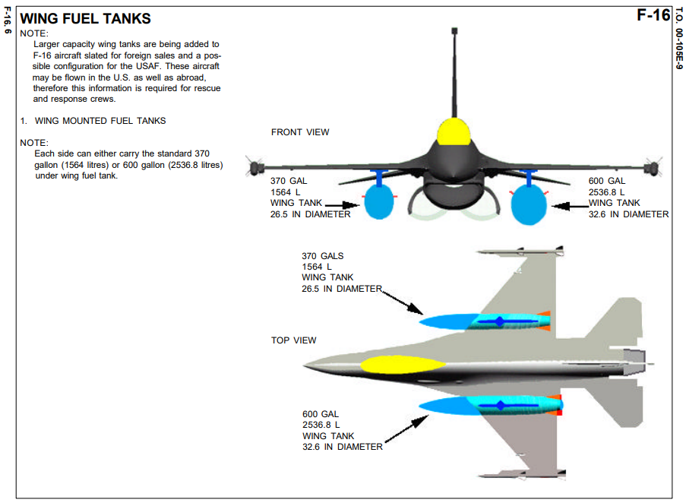

Slide 66


Slide 67


Slide 68


Slide 69


Slide 70


Slide 71


Slide 72
MIRAGE 2000

Slide 73


Slide 74


Slide 75
TORNADO

Slide 76


Slide 77


Slide 78
MB339

Slide 79


Slide 80


Slide 81
C-101

Slide 82


Slide 83


Slide 84
CN235

Slide 85


Slide 86


Slide 87


Slide 88


Slide 89
JAS-39

Slide 90


Slide 91


Slide 92


Slide 93


Slide 94


Slide 95


Slide 96


Slide 97


Slide 98


Slide 99


Slide 100
MIG-29

Slide 101


Slide 102


Slide 103


Slide 104
RAFALE

Slide 105


Slide 106


Slide 107


Slide 108


Slide 109


Slide 110


Slide 111


Slide 112


Slide 113


Slide 114


